Slide 1
TBT Agreement and medical devices
10 August 2022
Lauro LOCKS
lauro.locks@wto.org

Slide 2
Outline
Trade and regulatory cooperation are vital for expediting access to essential medical products.
Core TBT obligations of relevance to NRAs:
  International standards
  Facilitating conformity assessment procedures
  Transparency
The WTO TBT Committee can help find cooperative solutions to trade and regulatory bottlenecks.

Slide 3
Regulatory cooperation and trade
Regulatory cooperation and reliance avoids duplication and promotes more efficient use of resources by regulators and manufacturers
Narrowing unnecessary differences in regulation between countries has benefits for both health and trade (e.g. expediting registration, facilitating operation of supply chains)
Cooperation is especially important for NRAs with less resources to contend with increasingly complex technologies embedded in medical devices
Strengthening use of good regulatory practices (such as transparency, public consultation, and internal coordination) enables these efforts

Slide 4
International standards

Slide 5
International Standards
National Standards and Regulations
International Trade
TBT Agreement

Slide 6
TBT Agreement:
using international standards
Members shall use…
technical regulations
(Art. 2.4)
conformity assessment procedures
(Art. 5.4)
relevant international standards
Also: national standards
… as a basis for
when ineffective or inappropriate for policy objectives
(e.g. fundamental climatic or geographical factors, or technological problems)
except!

Slide 7
Facilitating conformity assessment procedures

Slide 8
Facilitating certification/registration (encouraged in TBT Agreement)
International or regional systems for conformity assessment (article 9)
  “Members shall, wherever practicable, formulate and adopt international systems for conformity assessment”
Recognition of foreign conformity assessment results (article 6)
  “verified compliance, for instance through accreditation, with relevant guides or recommendations issued by international standardizing bodies shall be taken into account as an indication of adequate technical competence”
  Encouragement to negotiate MRAs

Slide 9
Transparency

Slide 10
What to notify?
New or modified technical regulation or
conformity assessment procedure
+
No existing international standard or
Different from the international standard
+
Significant impact on trade
(restricting or facilitating)
NOTIFY

Slide 11
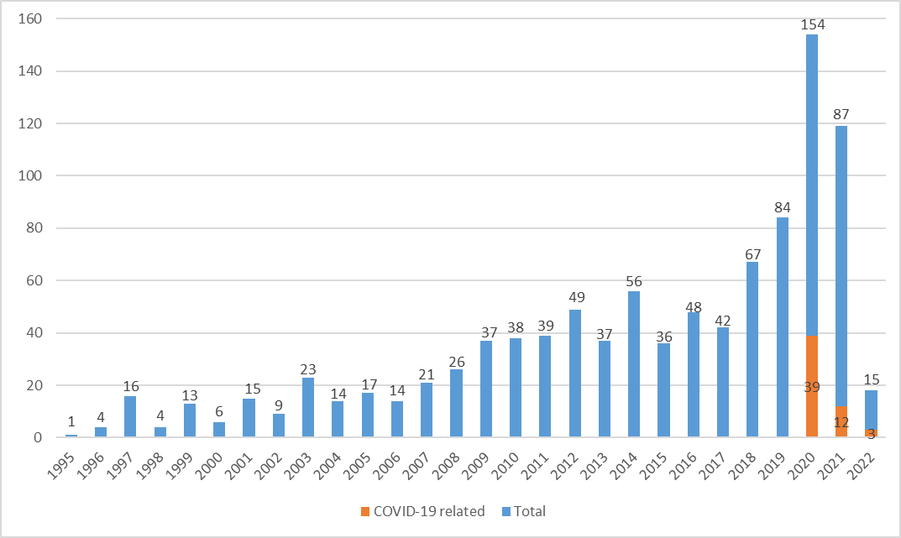
Notifications related to medical devices, by year

Slide 12
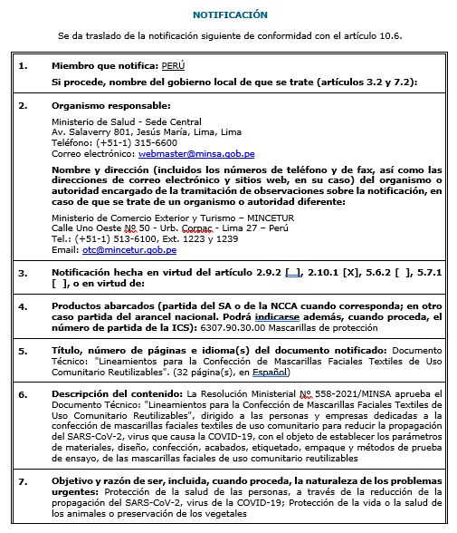
Some examples of notifications
Peru adopted Guidelines for the manufacture of reusable cloth face-masks for use by the community (G/TBT/N/PER/131)
(06/05/2021)

Slide 13
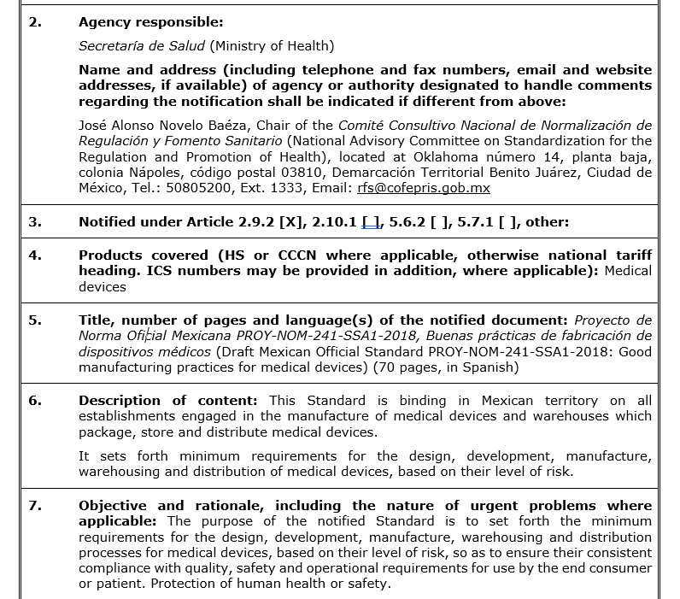
Mexico laid out minimum requirements for the design, development, manufacture, warehousing and distribution of medical devices, based on level of risk
(G/TBT/N/MEX/454)
(21/06/2019)

Slide 14
ADD EXAMPLE AFRICA

Slide 15
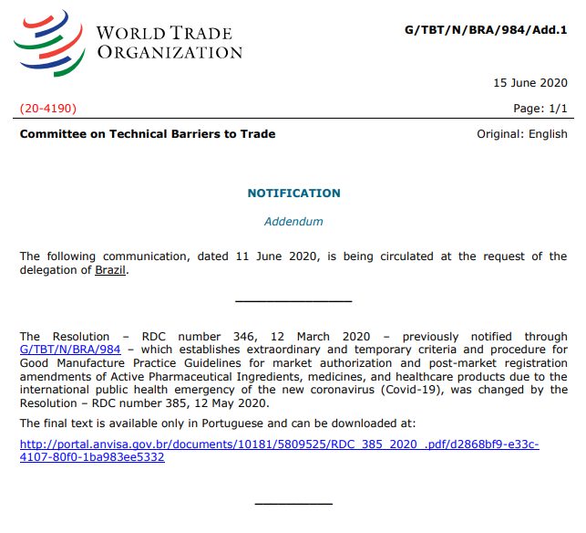
Recognizing certification by others: regulatory cooperation
Instead of conducting its own inspections of pharmaceuticals and medical device manufacturers, Brazil is accepting information from other regulators that participate in the Pharmaceutical Inspection Co-operation Scheme (PIC/S) and the Medical Device Single Audit Program (MDSAP). (G/TBT/N/BRA/984)

Slide 16
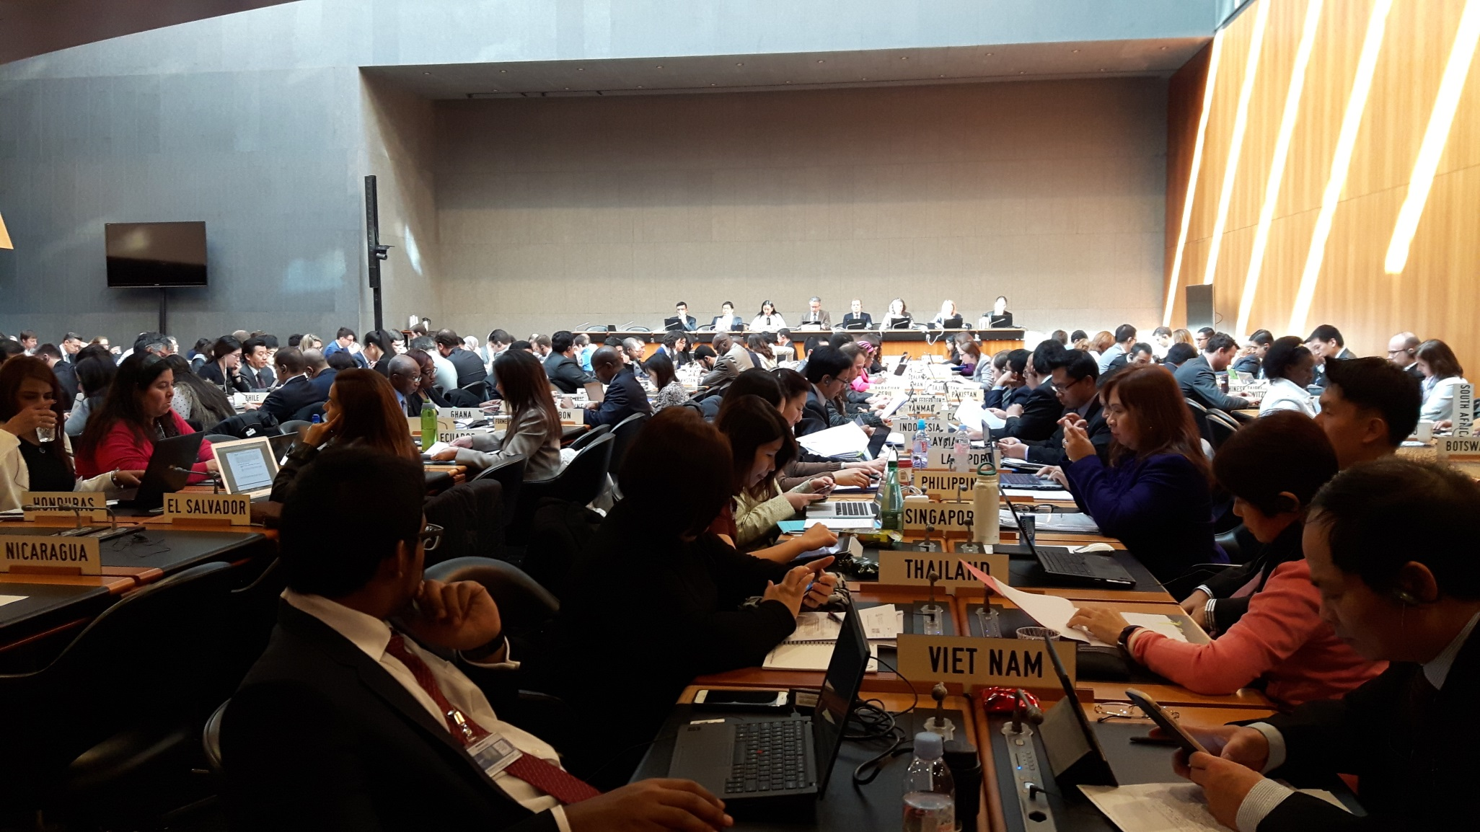
TBT Committee

Slide 17

Two main themes of Committee work
1
2
review of measures
“specific trade concerns”
(mostly based on notifications)
Information exchange on cross-cutting issues (harmonization, transparency, …): leading to decisions and recommendations

Slide 18
Examples of specific trade concerns (on agenda of March 2022 TBT Committee)
EU – Medical device regulation and In Vitro Diagnostic Medical Devices Regulation (STC No 594)
Raised 8 times since June 2019 by Canada, China, Japan, Korea, Mexico, Singapore, US
Issues include:
insufficient number of conformity bodies accredited to certify and test medical devices
insufficient number of implementing acts providing detailed guidance on compliance
China – Registration fees for drugs and medical device products (STC No 466)
Raised 20 times since June 2015 by Australia, Canada, Korea, Malaysia, US
Issues include:
Lack of equal treatment between exporters and domestic producers in imposing registration fees due to fee for foreign inspection

Slide 19
Key messages
Trade and regulatory cooperation are vital for expediting access to essential medical products.
Core TBT obligations of relevance to NRAs:
  International standards
  Facilitating conformity assessment procedures
  Transparency
The WTO TBT Committee can help find cooperative solutions to trade and regulatory bottlenecks.

Slide 20
Lauro.locks@wto.org

Slide 21
Examples of specific trade concerns (on agenda of March 2022 TBT Committee)
China – Regulations for the Supervision and Administration of Medical Devices (STC No 428)
  Raised 22 times since June 2014 by Australia, Canada, EU, Korea, US
  Issues include:
      Duplicative testing requirements
      Requirement to obtain market approval from the country/region of applicant’s business registration / production could restrict access to products not registered in country of origin
      Failure to recognize test reports issued by internationally accredited labs

